Slide 1



HAPTIC GLOVES for VR
AM5011
VIRTUAL REALITY ENGINEERING
Ramcharan Gudi - ME16B140
Abhishek Sureddy- ME16B166
Pawan Prasad K- ME16B179

Slide 2
OVERVIEW
VR world
Arduino
Glove Module

Slide 3
CAMERA
HAND TRACKING
VR WORLD
GAME OBJECTS
COLLIDERS

Slide 4
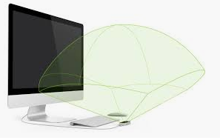
Camera
Motion capture using camera integrated with Unity
A single Leap Motion camera integrated with the VR environment
in Unity 3D
Device placed at location in vicinity of
hand’s range of motion
Workspace: 120 deg conical frustum
Frame Rate: 45-50 FPS

Slide 5
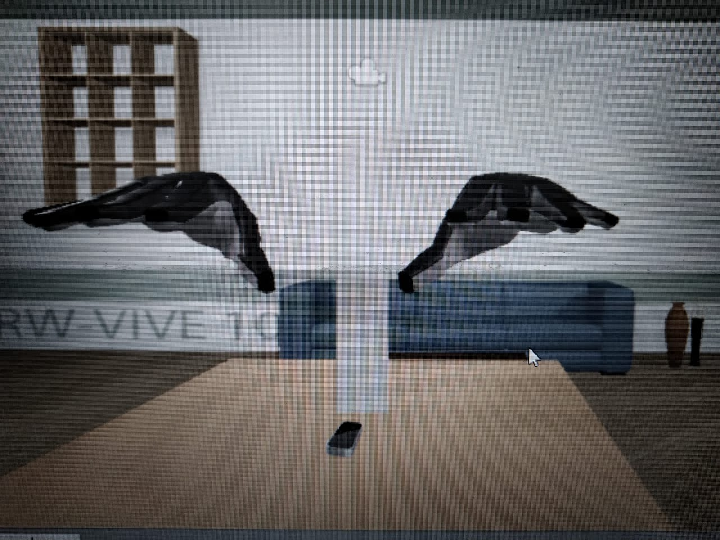
Hand Tracking
Movements modeled based on hand movement in the real world.
Hand Model rendered by calibrating with
respect to the Leap Motion device
Camera placed on “ table ”,
same as in real and virtual worlds
Virtual world calibrated with centre of
camera as location of world frame
Tracks both right and left hand in real time

Slide 6
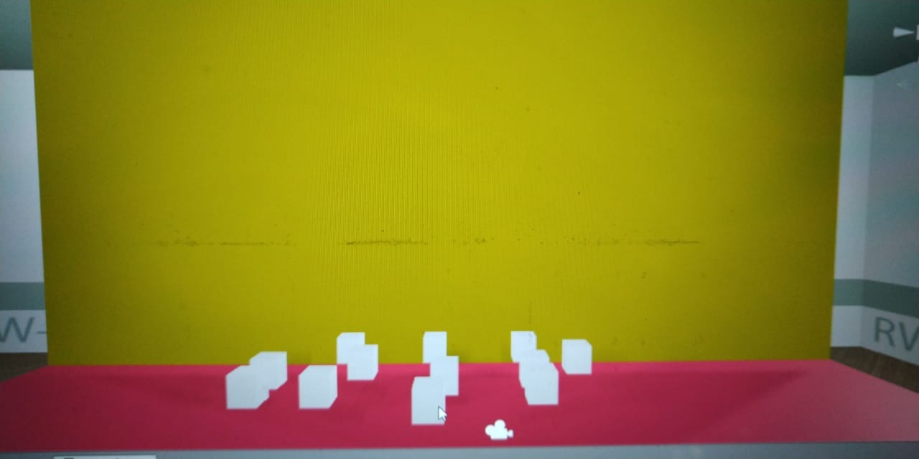
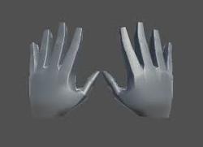
Game Objects
Randomly placed Cubes (rigid body) on a “ Table” for interaction.
The hand models in VR world are Game Objects
The hand represented as a “ Glove module” in the VR world.
Has 27 children components

Slide 7
Detecting Collisions
Initial Approach:
Coordinates are extracted from the hand model across the temporal dimension
Distances between solid blocks and hand are calculated
If the distance approached close to side length of the object -Trigger!

Slide 8
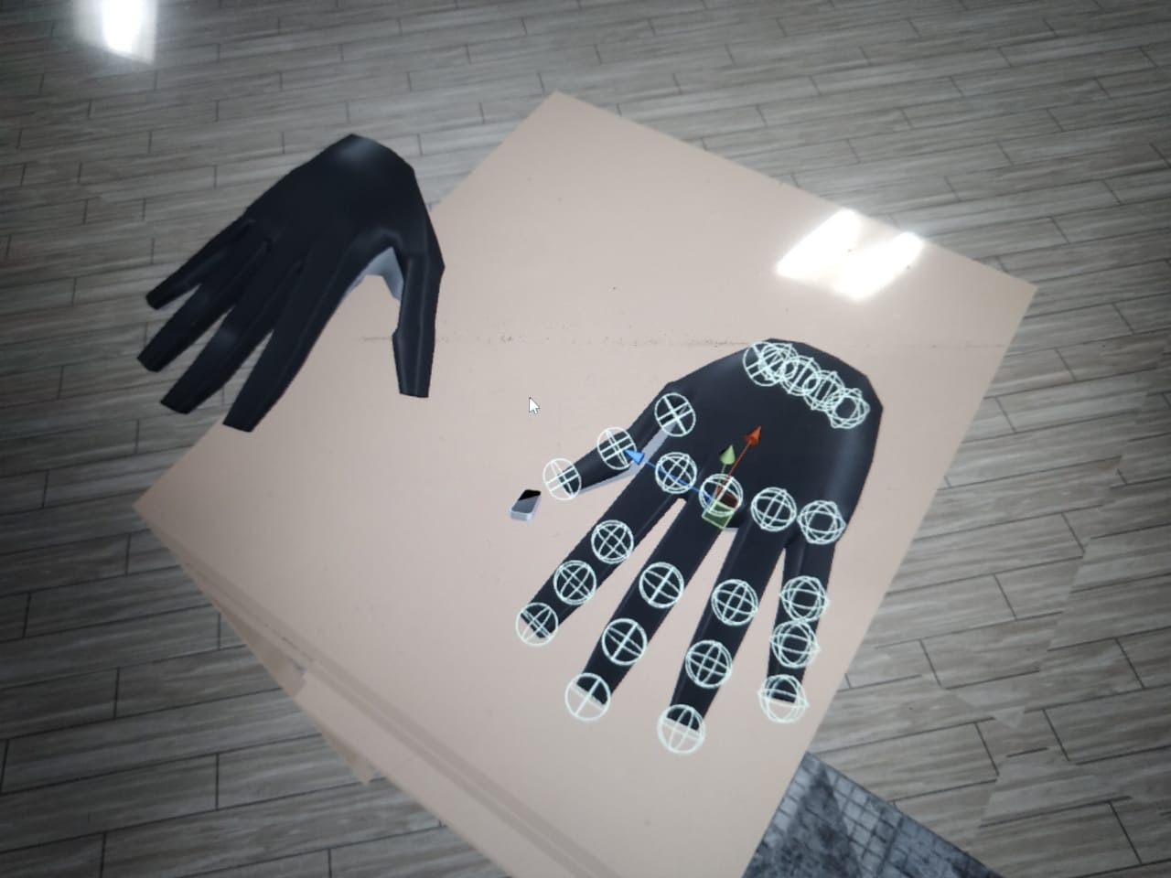
Colliders
Instead, all Game objects equipped with collider, with mesh, larger than its size
When both physical spaces of Hand and Object come in
contact, they produce a trigger
Implemented with C# script
In this way, model can be simplified
Very less computational cost

Slide 9
TRIGGER
RELAY
INPUT

Slide 10
Collision Trigger
When player interacts with cubes, a trigger signal is generated
C# Script for communicating between Unity and Arduino via PC serial ports
Testing a Toy Example:
LED output for collision
Trigger sent to Arduino which activates respective sensors in glove module

Slide 11
Input
Collision Trigger
Serial port of the computer is tethered to the arduino through the port.
The arduino receives 2 kinds of inputs from the port.
The arduino is programmed prior to act certainly based on the input received.
The arduino output is derived from a designated pin as - 0 or 1

Slide 12
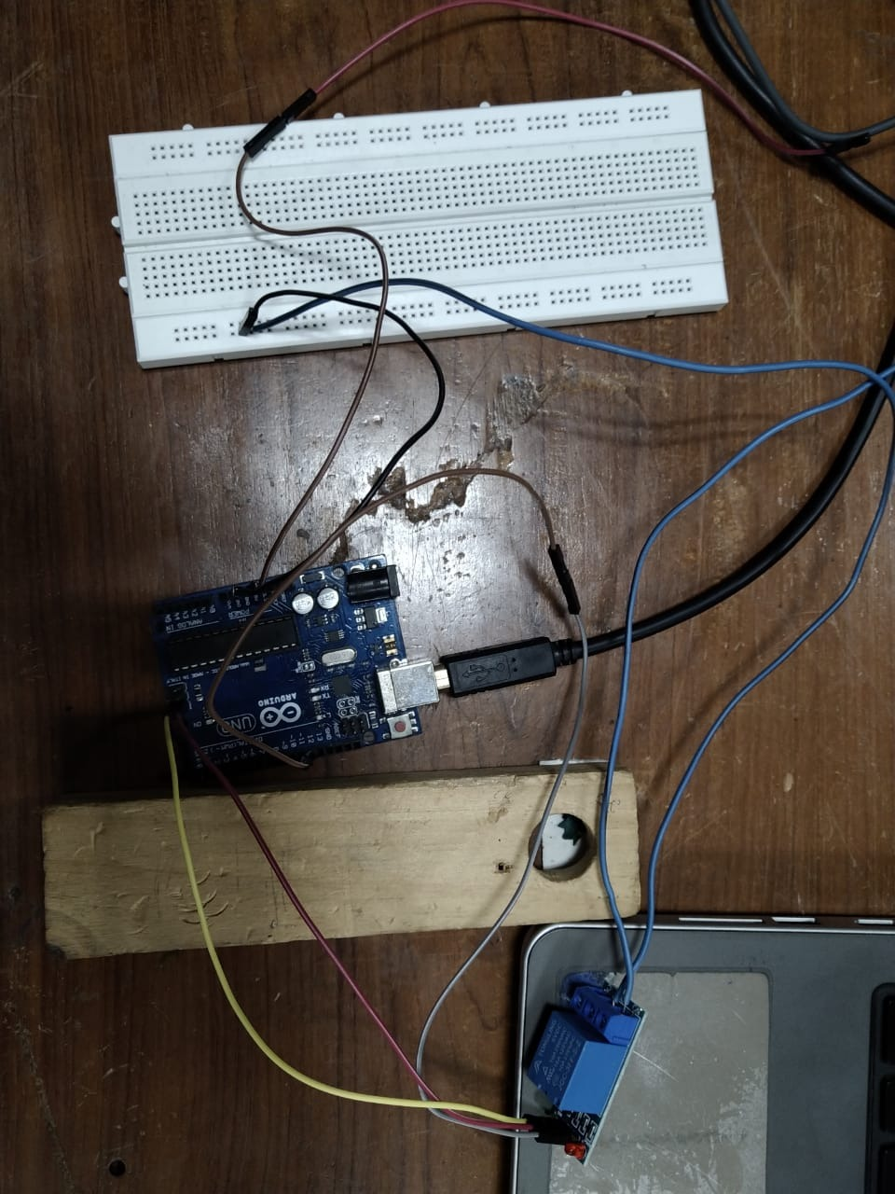
Relay Control
The output from arduino is fed into Normally Closed
Common is grounded
If arduino output is
0 - the relay receives no input, the system is shorted,
switch ON
1 - this input directly, and the switch OFF
Relay placed in the middle of circuit containing the haptic sensors
Arduino Uno
Relay Switch

Slide 13
CIRCUIT
COMPUTER
-VE +VE
RELAY
ARDUINO UNO
-10
- GND
NC -
COM-
NO -
-INT
-GND
-VCC
-VCC
P
ELECTRODE
PELTIER MODULE
KINESTHETIC MOTOR

Slide 14
CUTANEOUS
KINESTHETIC
GLOVE
TACTILE
THERMAL

Slide 15
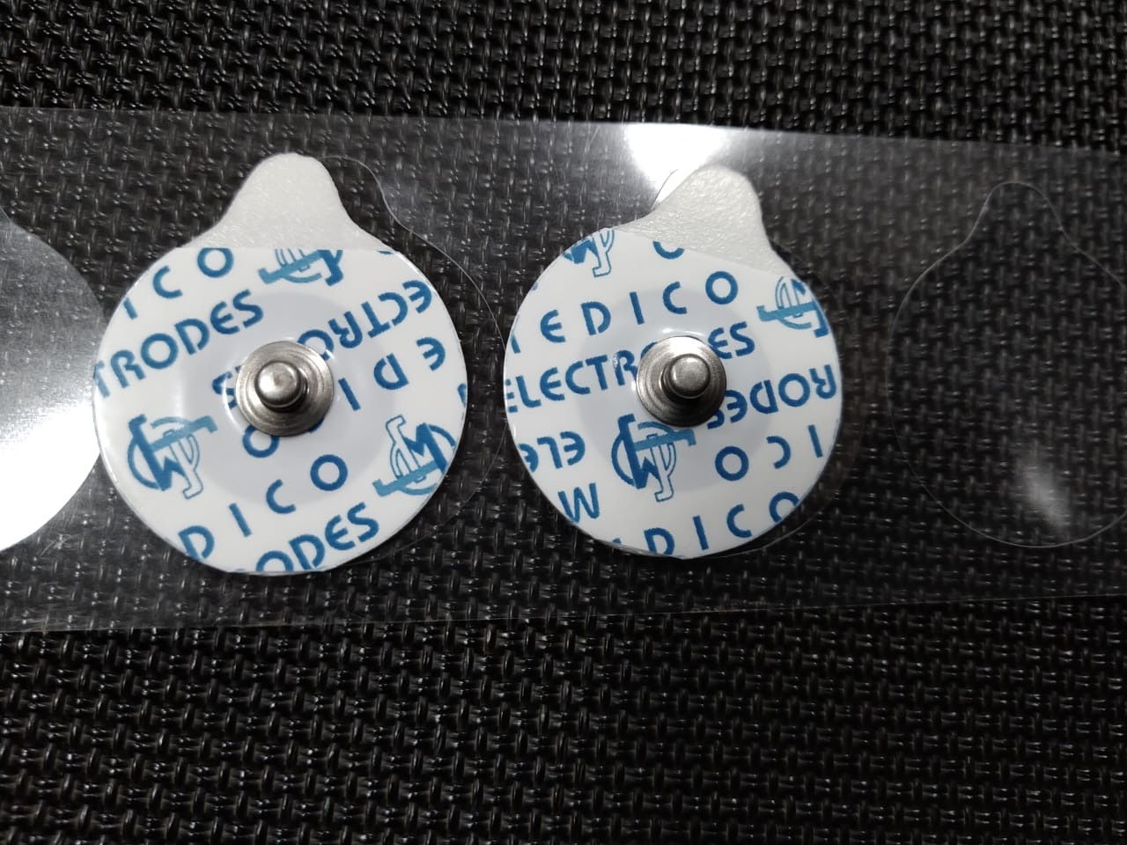
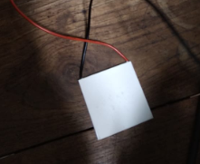
Cutaneous Feedback
We provide two types of cutaneous feedback
Electro Tactile:
ECG electrodes - available as discrete units
can be embedded in a modular setup.
Thermal:
Peltier Thermo-electric cooler

Slide 16
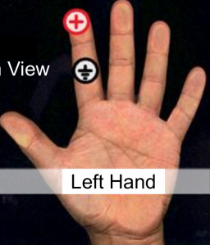
Electro-Tactile feedback
ECG electrodes are stuck at 2 points on a finger
Second electrode completes the circuit.
Input Voltage Required: 9-10 V
Electrode properties:
Comprises Ag-AgCl Mixture
Stainless Steel tip for conduction

Slide 17
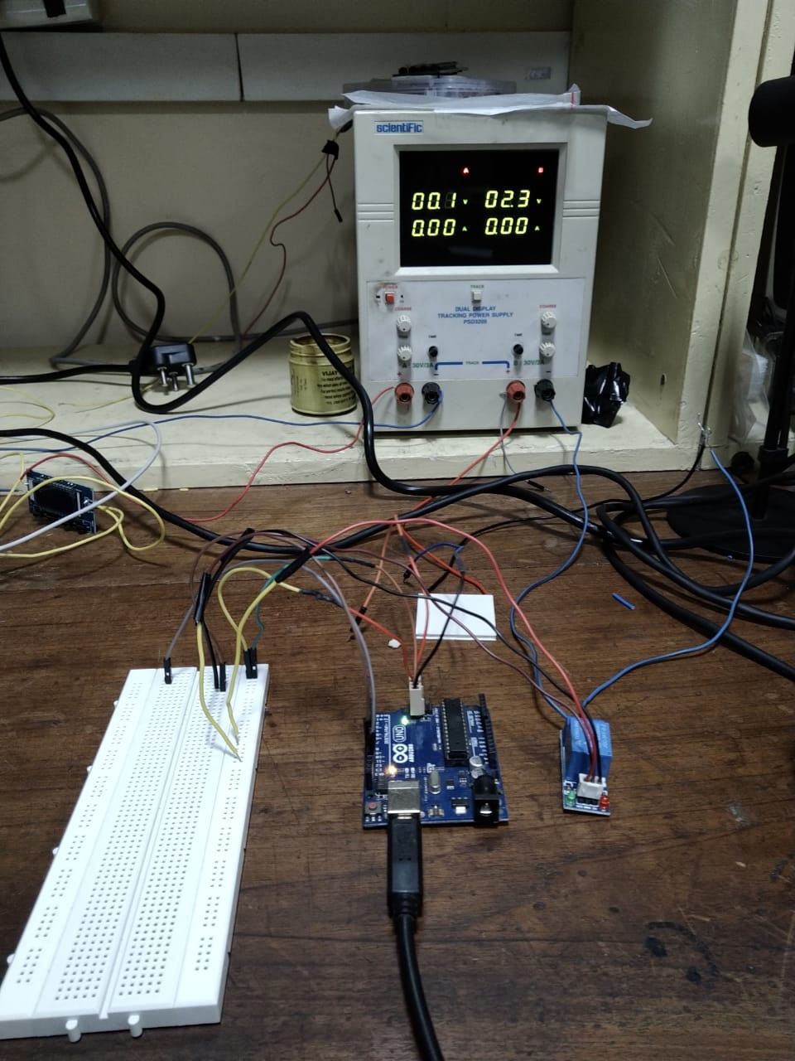
Thermal Feedback
Peltier Effect:
Temperature Difference when current passes via
junction between two materials
Input Voltage required = 2-3 V
We use 2 Peltier sensors - for HOT and COLD
objects
Positioning: One Peltier is inverted with respect
to the other

Slide 18
Kinesthetic Feedback
Use of physical systems to constrain the hand movement.
Electrostatic / Magnetic brakes are efficient, but require very high voltages - not feasible in an educational setting
Mechanisms such as ones using skeletal linkages increases load and complexity of the system
Simple mechanical systems are used to constrain fingers: string and motor

Slide 19
Kinesthetic Feedback
Goal: To restrict the “fist-closing” action when obstructed by a rigid object in VR
.
Immersive nature of the mechanism is the important factor to consider.
Need a mechanism to restrict individual finger movement
Challenges:
Actuator has to be light-weight while providing the required counter-torque
to restrict individual finger movement
We use a micro-servo motor to achieve the same

Slide 20
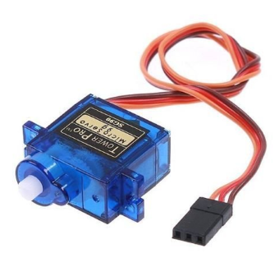
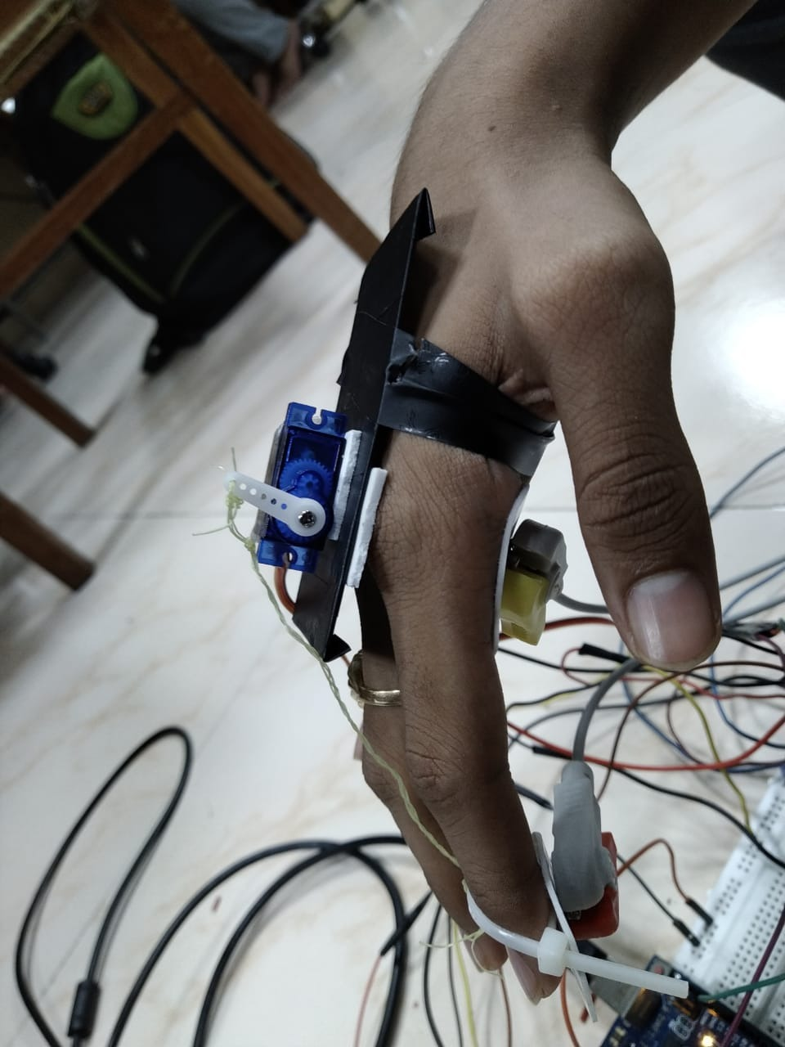
Servo Motor
Specifications:
Weight: 9g
Torque: 1.8kg-cm
Allowed Rotation: 0-180 deg
We mount the micro-servo motor on outer palm
We attach an inelastic Nylon string and tether it
between motor and finger tip

Slide 21
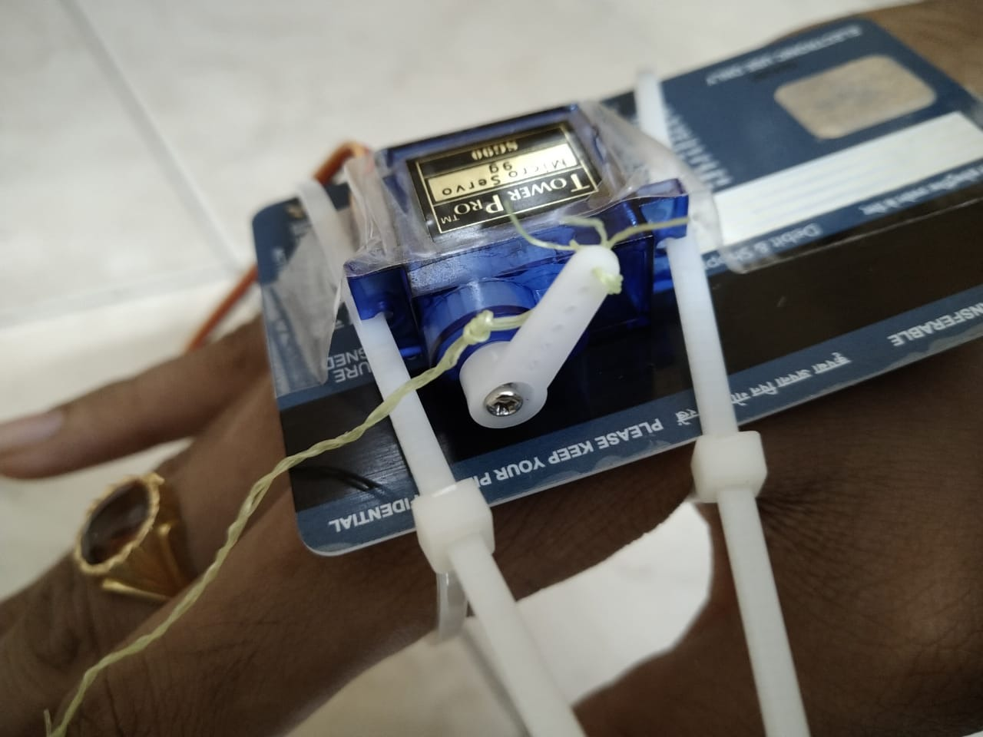
Design Decisions
If mounted on the naked hand, user experiences
a reaction force at the corresponding point.
To mitigate this problem, we mount the motor on
a planar body which is fastened to the hand
This allows the reaction to be distributed uniformly
across the plane body.

Slide 22
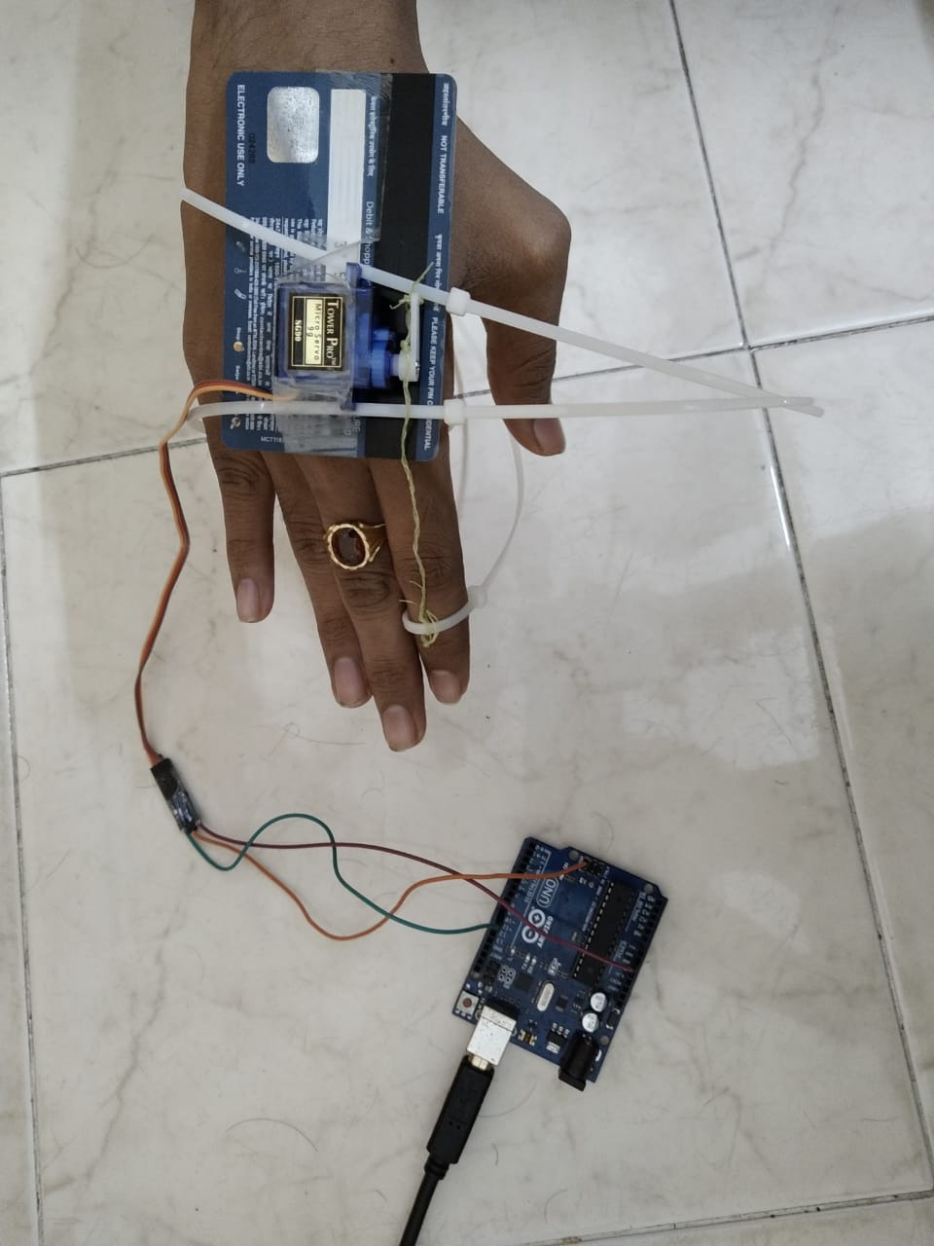
Working
The control comes from Arduino
Arduino
Actuation
Counter-Torque
Collision
Motor
String

Slide 23
SUMMARY

Slide 24
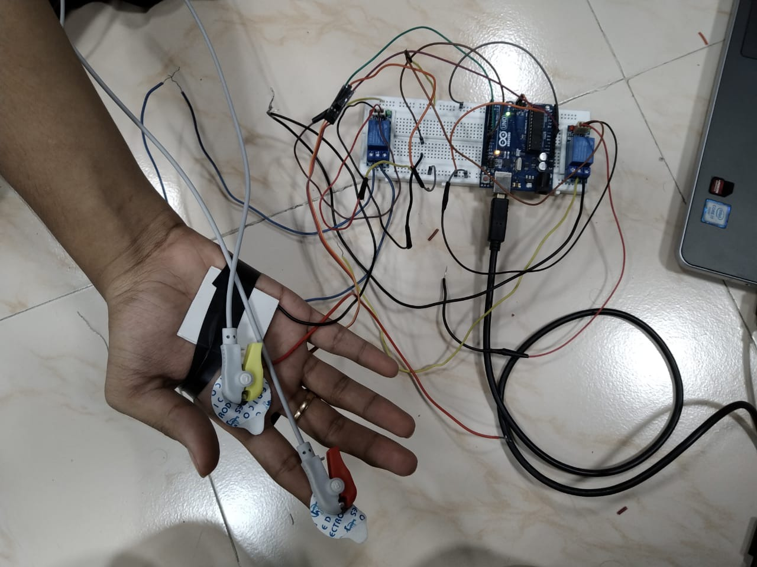
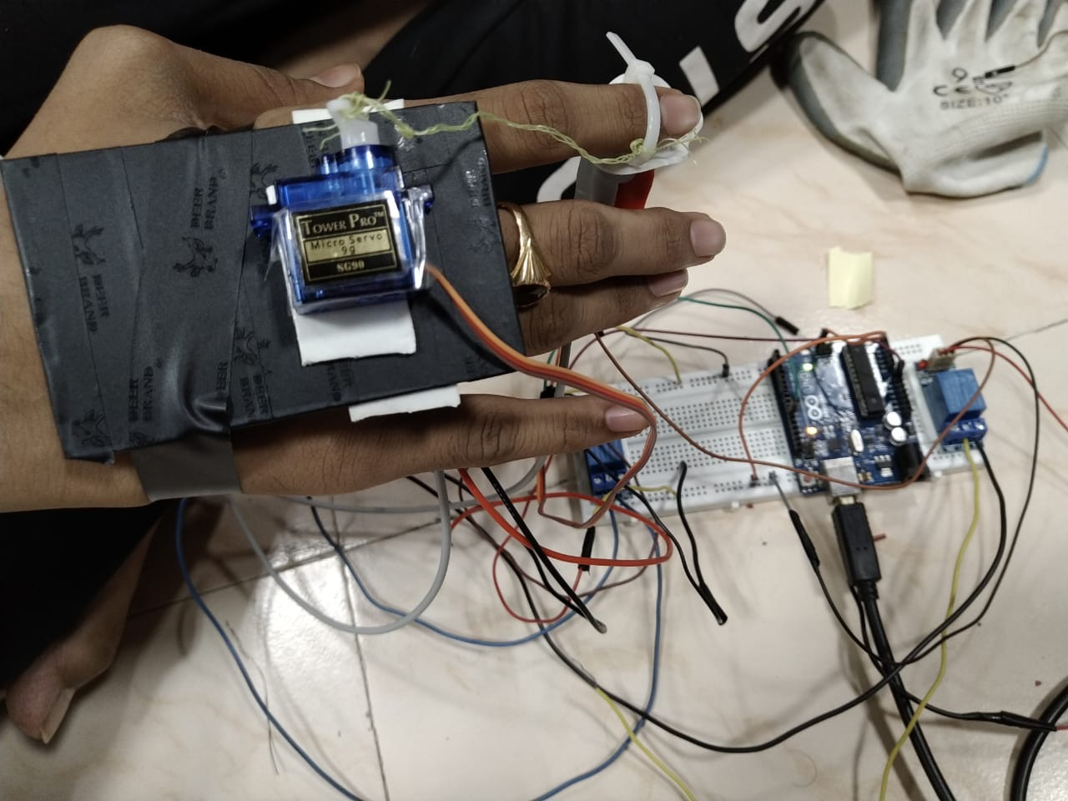

Slide 25
Results
Index finger-tip considered as the trigger initiator.
Finger contact with virtual object:
Unity recognises the trigger collide, sends output via serial port to Arduino
Arduino reads the output and produces binary output
Relay closes / opens
Closed relay produces corresponding Tactile, Thermal, Motor feedback

Slide 26
Future Works
Glove can be made more portable with mobile tactile systems involving harmless voltage requirements
Design of MicroMechanical systems, light enough to not burden the user and also is able to regulate 5 finger motion.
Calibrate the hand motion using universal cameras to give a better range of motion
Reduce time-lag between different sensor sub-systems

